Slide 1
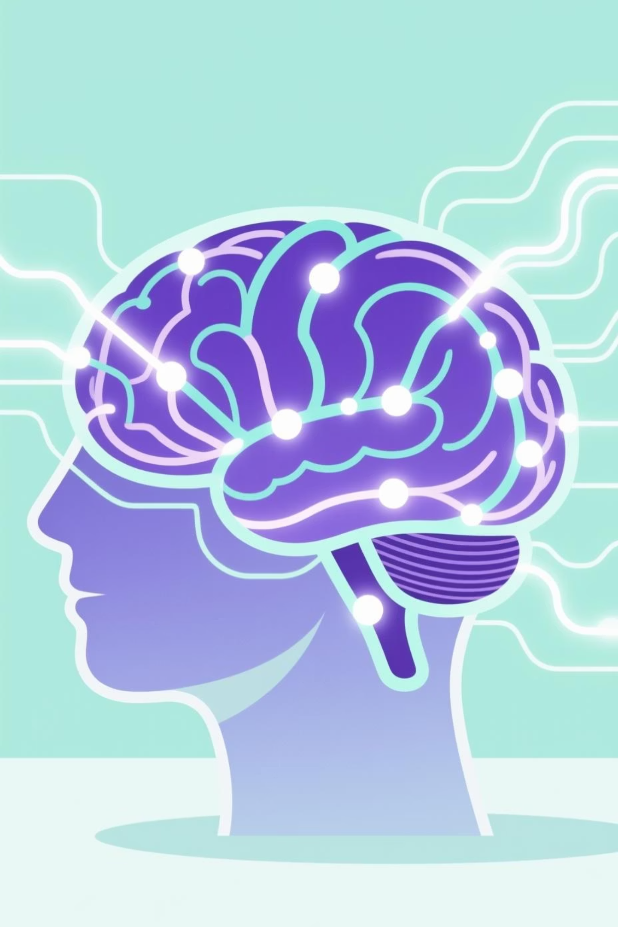
MindPulse AI
Tracking Emotions. Empowering Well-being.
A professional AI-powered Sentiment Dashboard for mental health and emotional well-being trends.

Slide 2

The Challenge
Why AI for Mental Well-being?
Critical Monitoring
Data-Driven Insights
Identify early mental health warning signs across communities and platforms.
Provide actionable insights for awareness campaigns and well-being programs.
Scale & Reach
Help organizations, counselors, and universities monitor large populations efficiently.

Slide 3








AI Emotion Detection: How It Works
MindPulse AI uses advanced NLP and image analysis to detect nuanced emotional tones.
NLP Analysis
Data Collection
Analyze text for emotional tones: stress, anxiety, joy, sadness, anger, calm.
Social media, news, comments, and user journals.
Dashboard Visualization
Image Sentiment
Upload feature to analyze emotional sentiment in images.
Visualize mood patterns and sentiment over time.

Slide 4
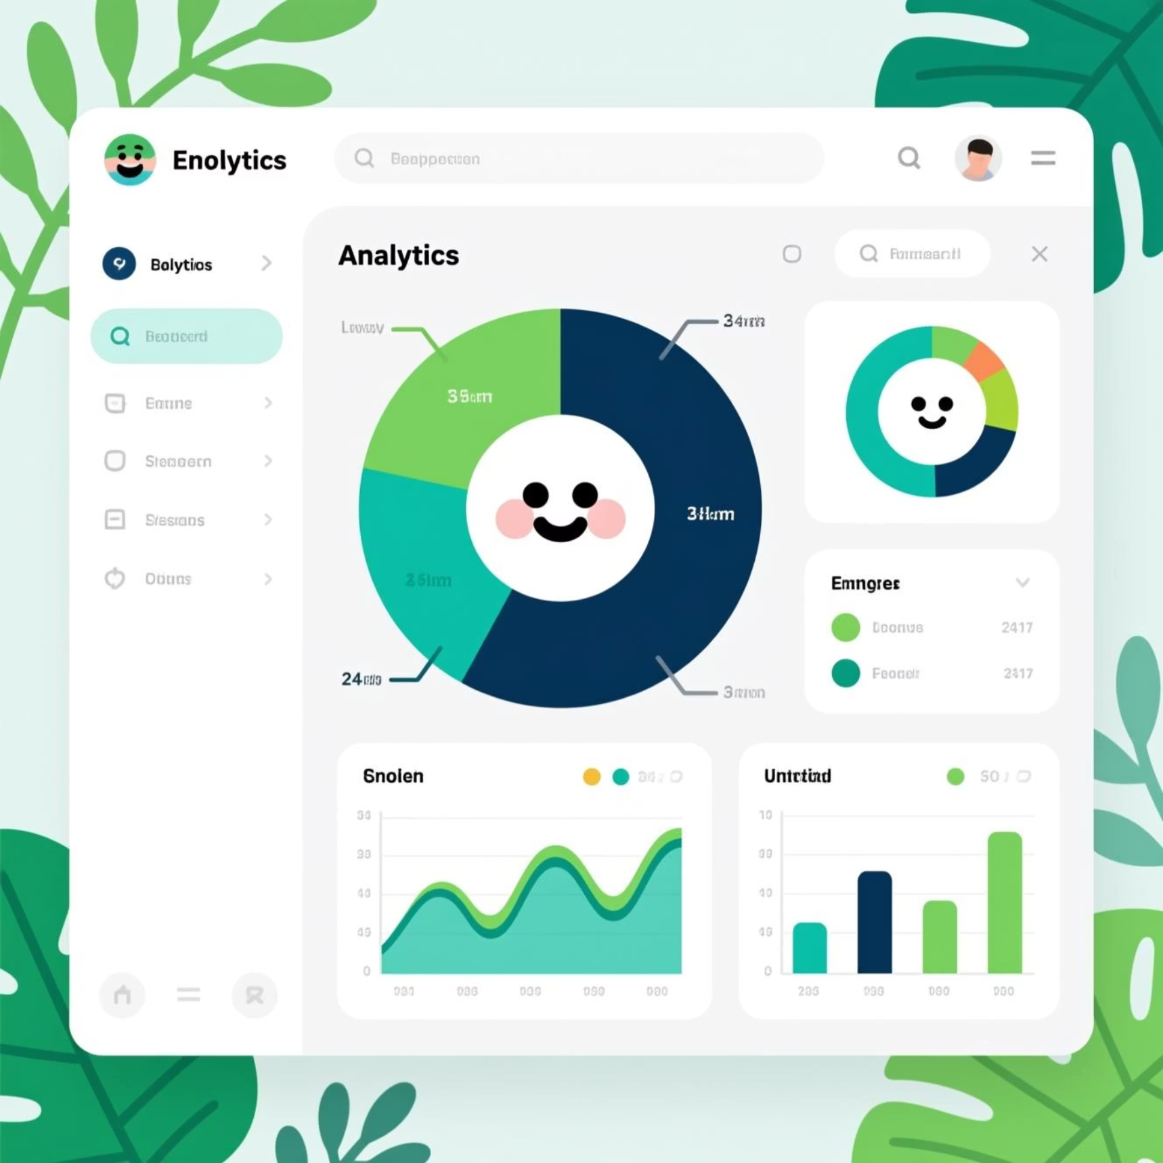
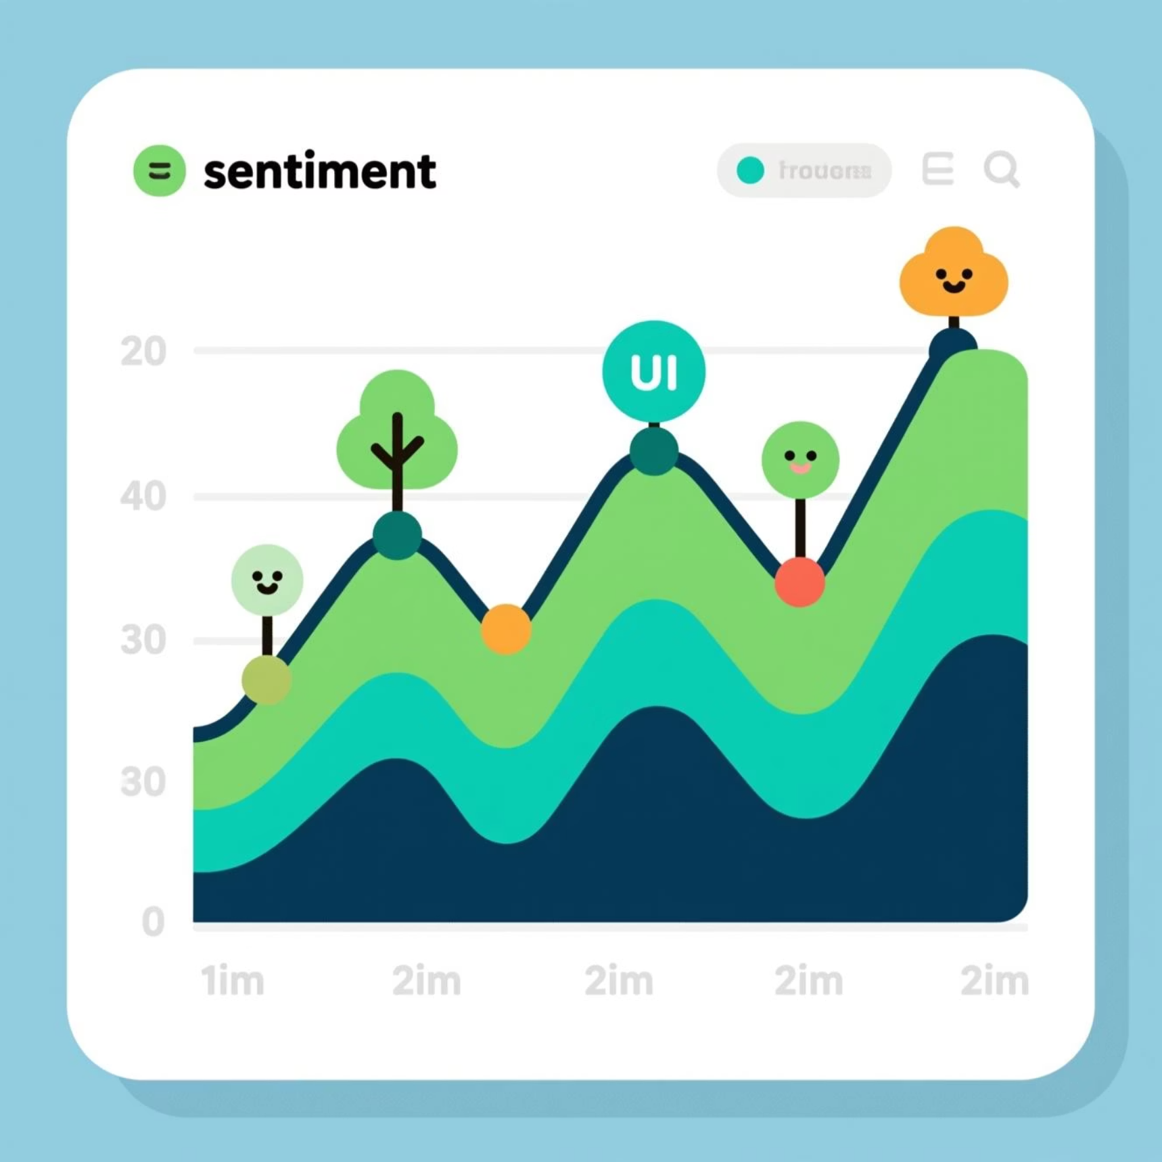
Core Analytics Features
Emotion Distribution Dashboard
Sentiment Timeline
Visualize the breakdown of Joy, Sadness, Fear, Anger, and Calm across your community with intuitive pie charts.
Track mood shifts daily, weekly, or monthly to identify patterns and seasonal trends in collective emotional health.

Slide 5

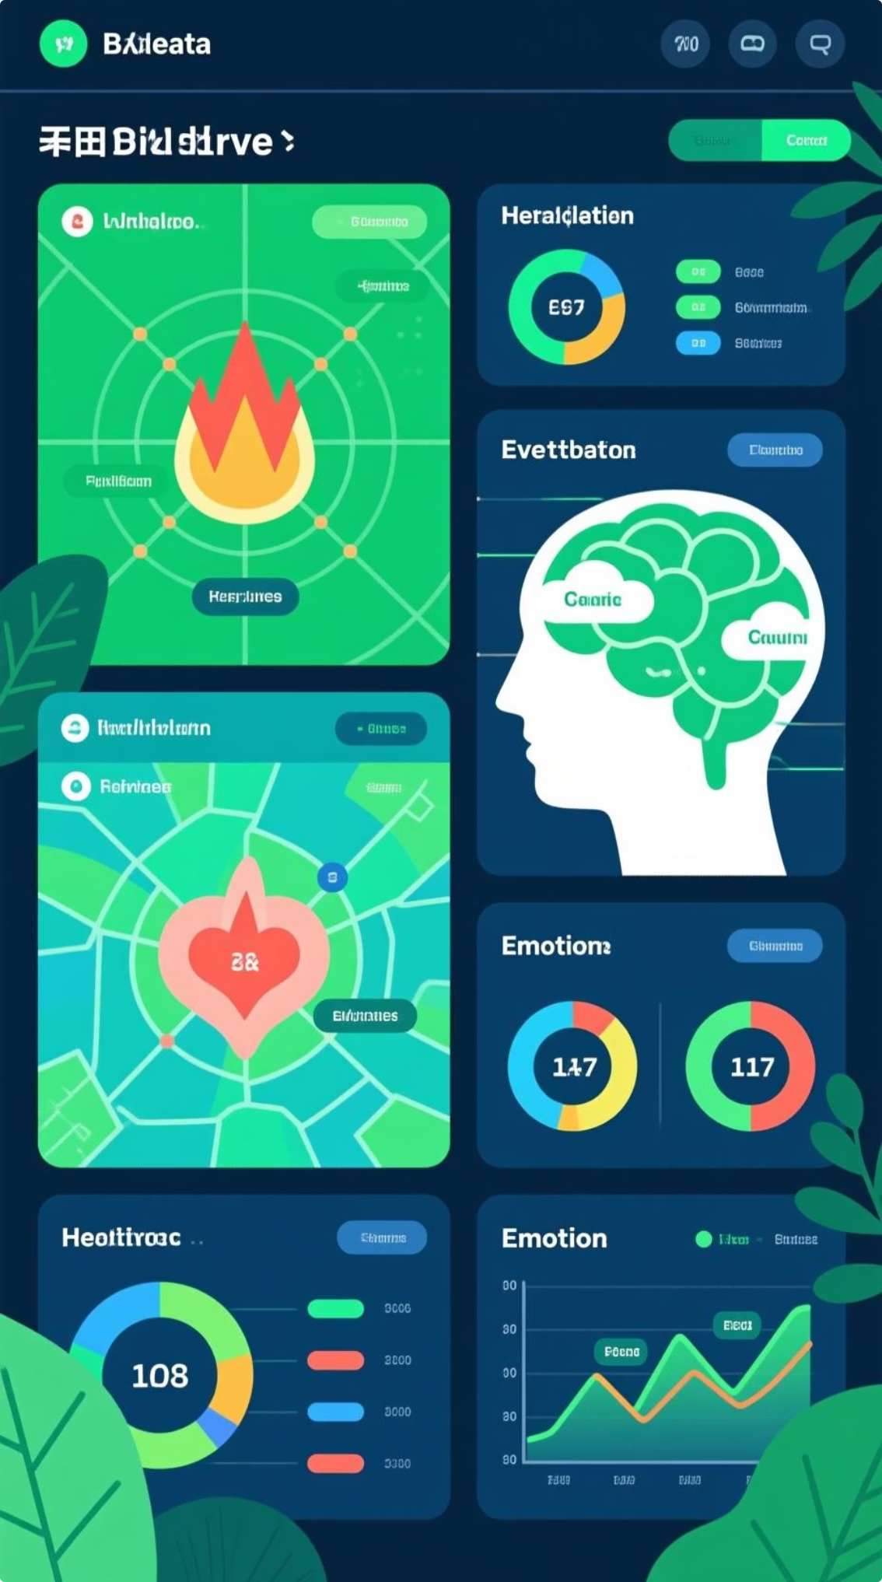
Advanced Intelligence Tools
Geo Heatmap Analysis
Identify high-stress regions or campuses at a glance. Color-coded maps reveal emotional hotspots and areas of positive well-being.
Event Correlation Engine
Automatically detect spikes in stress or sadness tied to exams, deadlines, or social events. Understand triggers and plan interventions.
Word Cloud Intelligence
Visualize the most common emotion-related keywords and phrases in your community's conversations.
Emotion Comparison Charts
Compare sentiment patterns across age groups, regions, or departments to tailor support strategies effectively.

Slide 6




Smart Features for Proactive Care
AI Wellness Assistant
Chatbot suggests resources when stress levels are high.
Mood Prediction Engine
Predict future emotional trends based on historical data.
Trend Triggers
Set alerts for sudden spikes in negative sentiment (distress signals).

Slide 7
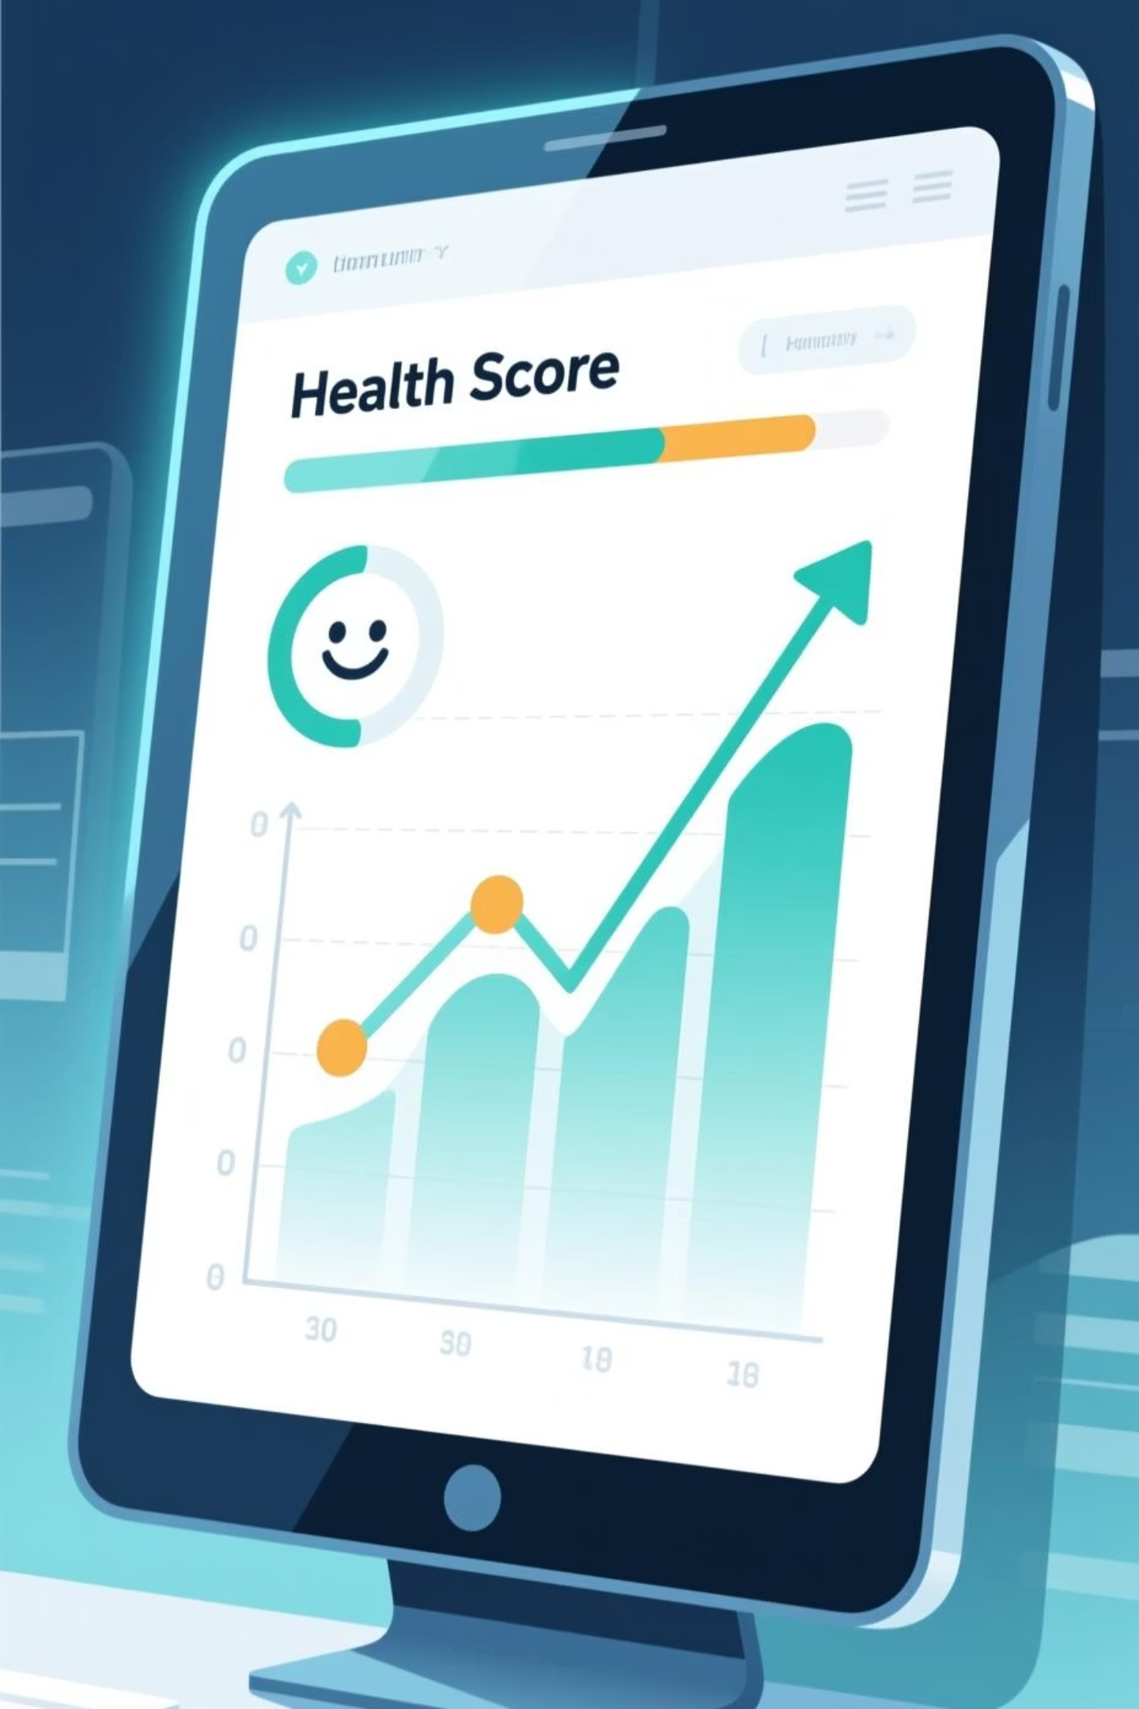
Measuring Community Wellness
78
8%
24/7
Community Health Index
AI Summary Card
Anonymous Portal
Composite "Mental Wellness Score" (0–100 scale) for each region.
Automatic insight: "Stress levels rose by 8% during exam week."
Users share feelings today, contributing to live, ethical data.

Slide 8
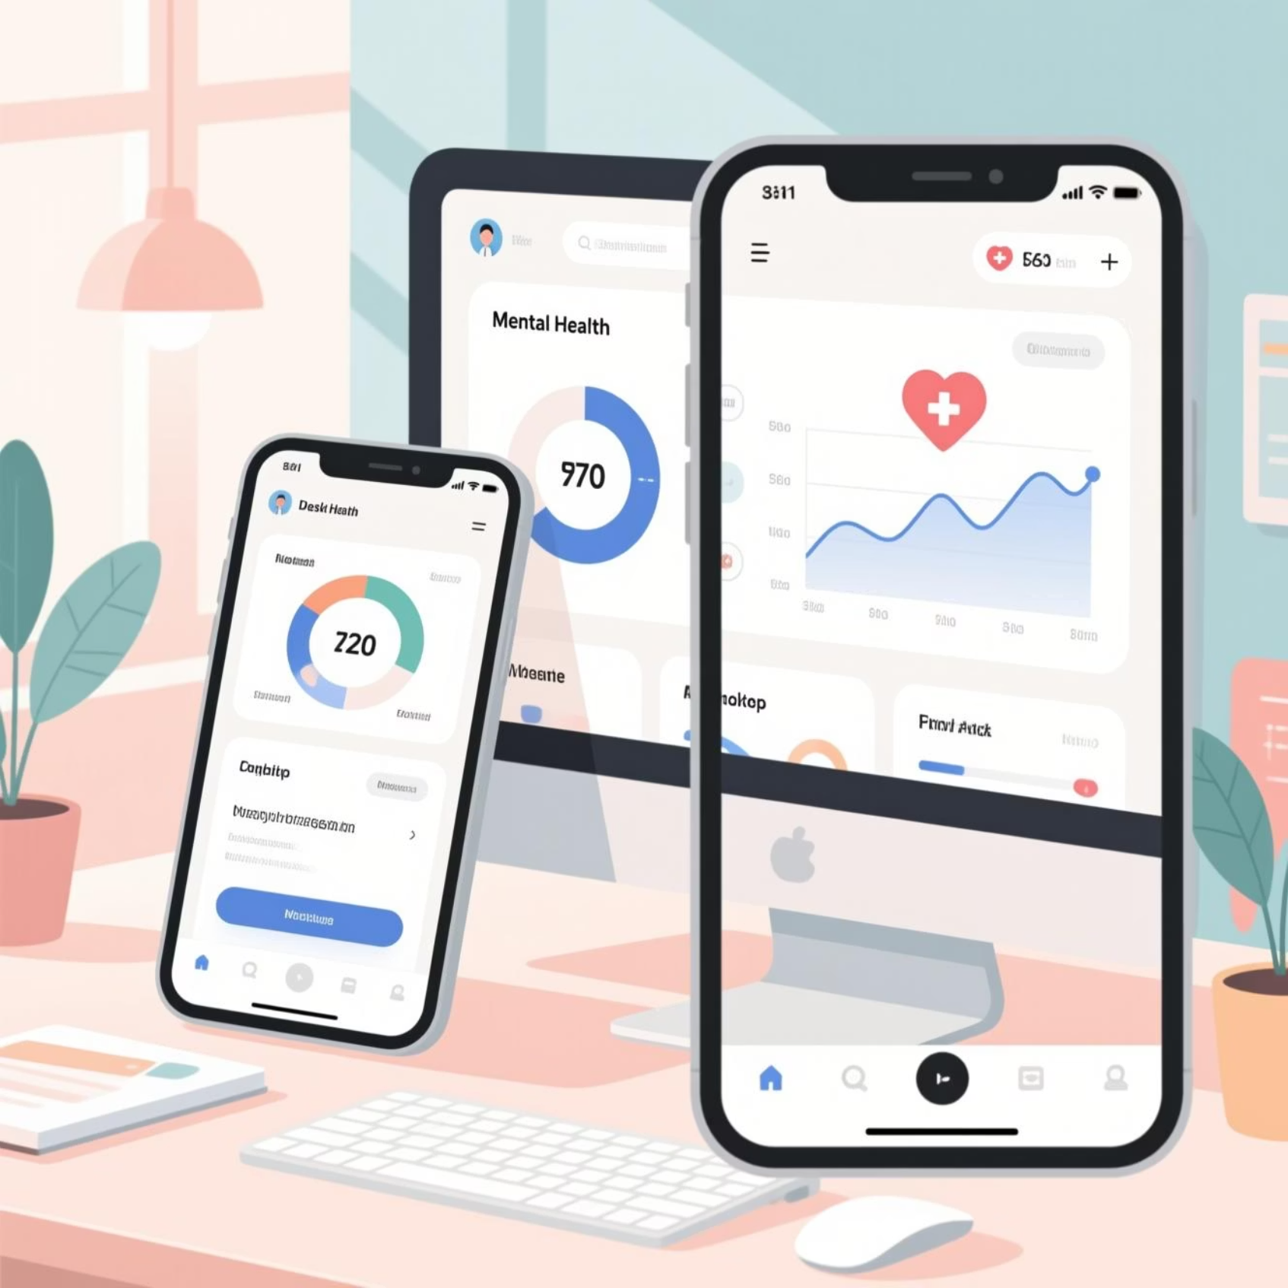
Design & User Experience
A responsive, calm interface optimized for all devices.
Responsive Interface
Optimized for desktop and mobile use.
Calm Design
Minimalist aesthetic with soft pastels, white, and mint green.
Dark Mode
Enable light/dark modes for better user experience.

Slide 9



Ethics and Transparency
Our commitment to privacy and ethical AI practices.
Data Anonymization
User Consent
Ethical AI Practices
Ensuring all user data is protected and non-identifiable.
Clear policies on data usage and user permissions.
Commitment to unbiased and responsible AI development.
Empowering Well-being, Responsibly.

Slide 10

The Path Forward
MindPulse AI empowers universities, organizations, and communities to build a culture of emotional awareness and proactive mental health support. By combining compassionate technology with human-centered care, we create environments where well-being thrives.
🎯 Detect
Early warning signs through real-time emotional analysis.
📊 Understand
Deep insights into community emotional patterns and triggers.
💡 Support
Targeted interventions and resources where they're needed most.
🌱 Thrive
Build communities where mental wellness is measurable and prioritized.

Slide 11
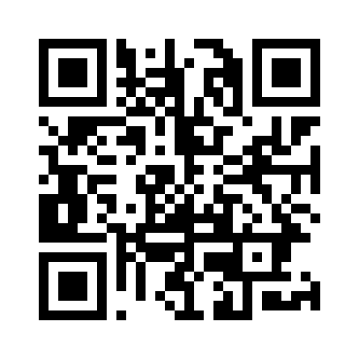
MindPulse AI
Thank you
Q&A

